Slide 1
Agriculture fair 2015
-seminar-
„ FADN IN SERBIA“
mr Mirjana Bojcevski
Sektor za poljoprivrednu politiku

Slide 2
PROMOTION MATERIALS ON THE MINISTRY OF AGRICULTURE AND ENVIRONMENT STAND
SEMINAR IN CONFERENCE PLACE
Name of seminar: „FADN in Serbia“
Time and place:
12 May 2015, from 1 p.m. to 3 p.m.,
Congress Centre ’Master’, Hall 3, Novi Sad Fair.
Invitation:
33 data colectors
2 Agriculture producers in FADN
Others
Other institution:
Agriculture faculties
Statistical office
Associates..

Slide 3
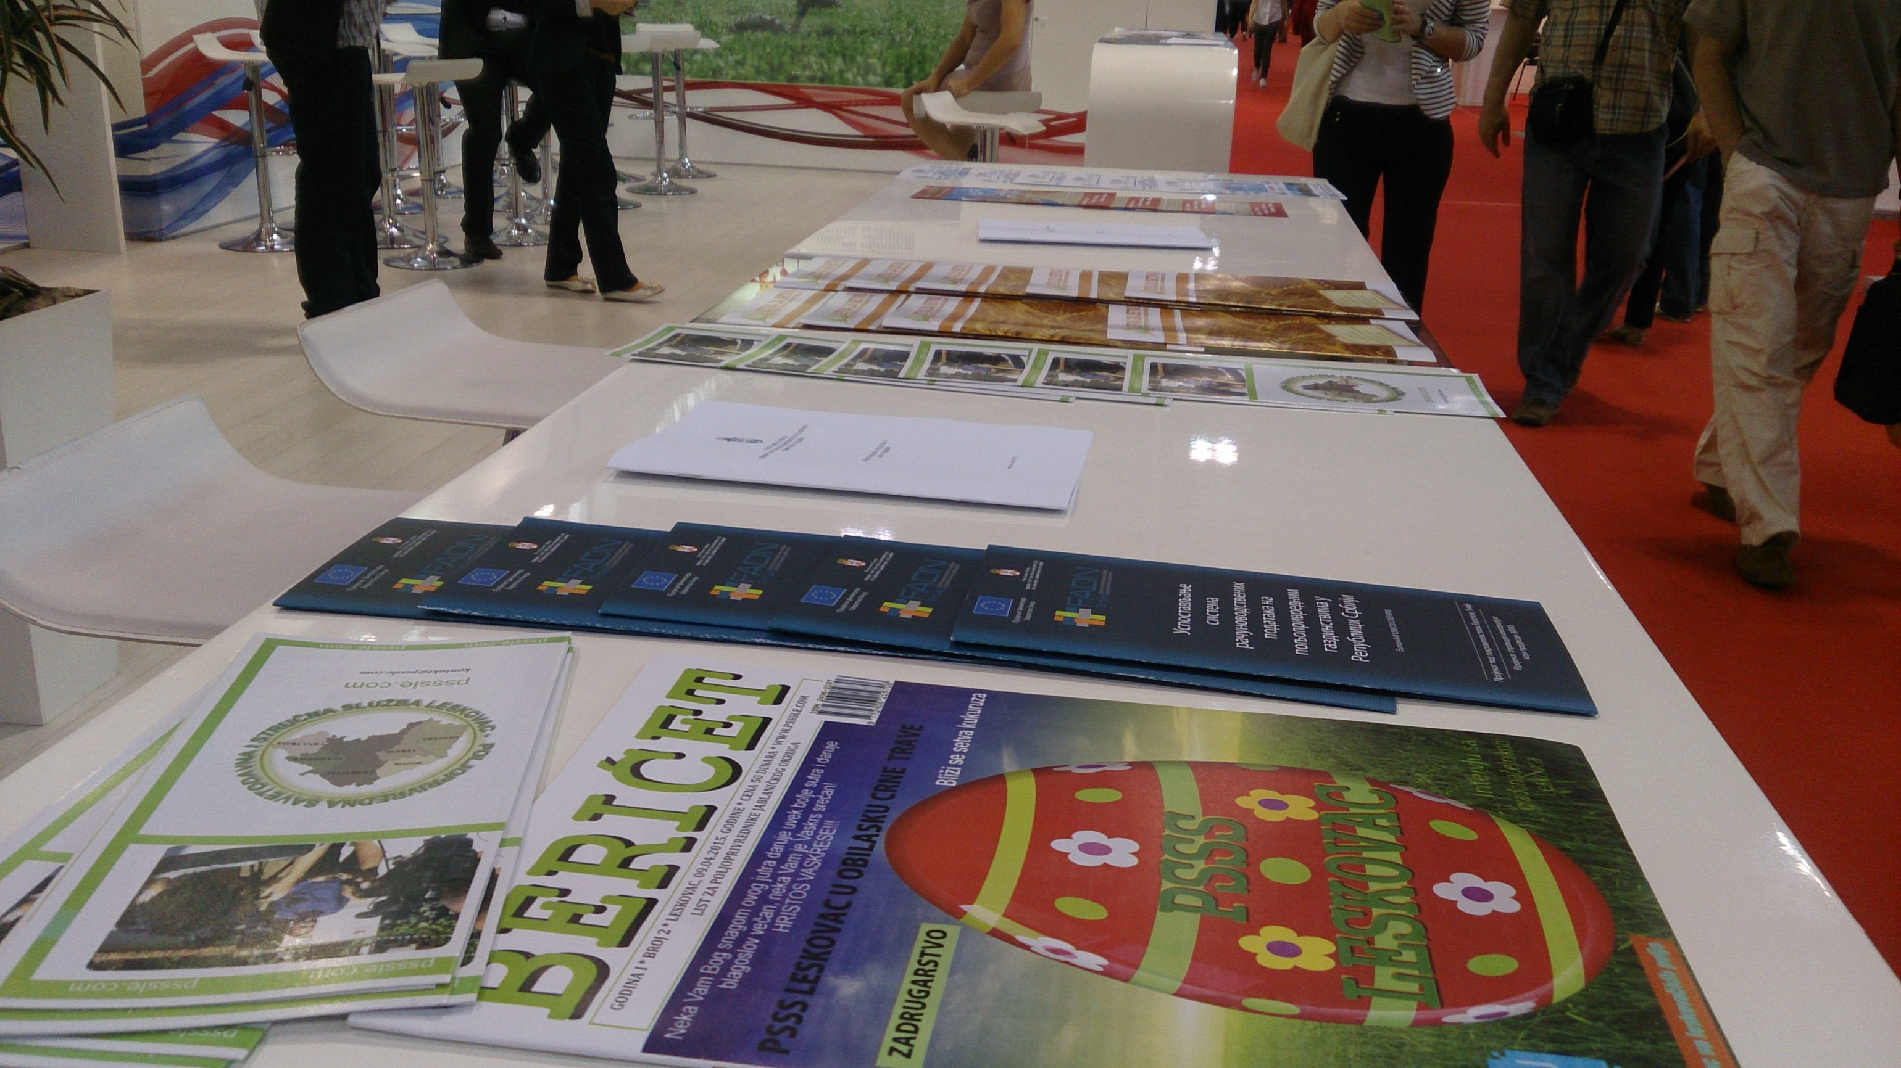
PROMOTION FADN MATERIALS ON THE MINISTRY OF AGRICULTURE AND ENVIRONMENT PROTECTION STAND

Slide 4
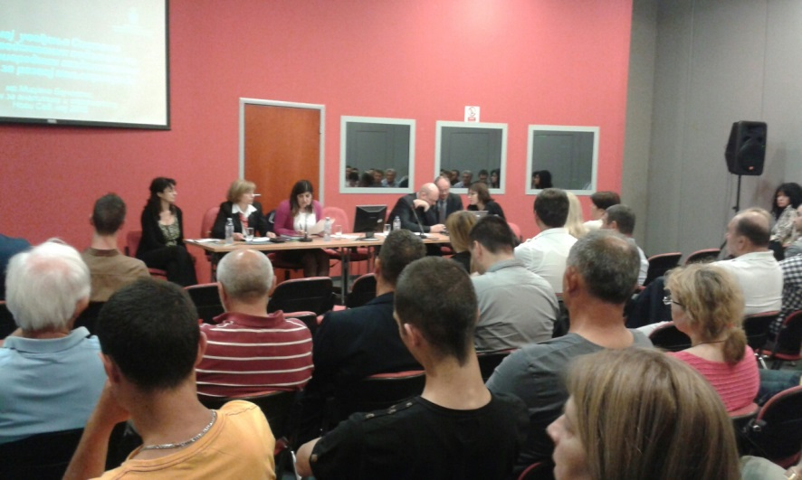
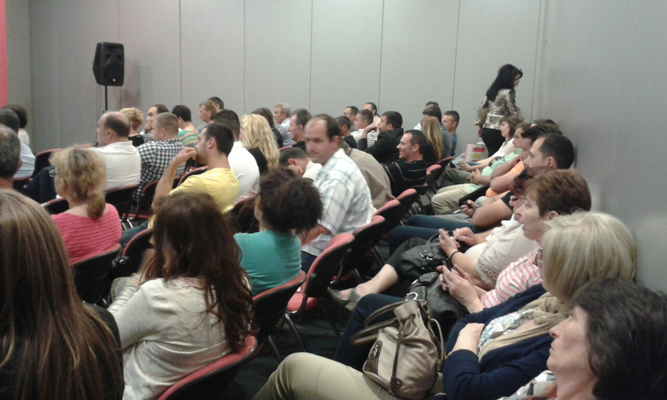
SEMINAR IN CONFERENCE PLACE

Slide 5
Presentation:
„Harmonisation of Serbian FADN with EU requirements“
European Union experts working on the establishment of FADN in the Republic of Serbia,
Henry Jorgensen, Morten Sojersen
„Importance of introduction of the Farm Accountancy Data Network (FADN) for the development of agriculture“
Representatives of the Ministry of Agriculture and Environmental Protection
mr Mirjana Bojcevski

Slide 6
„Experience of Regional bodies in relation to FADN data collection process and recommendations for the forthcoming period“
Provincial Secretariat of Agriculture, Water Economy and Forestry and Institute for Science Application in Agriculture (IPN)
dr Slavica Čolić, Julkica Simić
„Importance of FADN for economic analyses and scientific research in terms of improved production at farms“
Faculty of Agriculture, Novi Sad
prof.dr Veljko Vukoje

Slide 7
„Experiences of extension officers in FADN and contribution of FADN to improved quality of providing agricultural extension“
Agricultural Advisory and Technical Services and Agricultural Technical Services
Dusan Despotovic, Loznica
Goran Jurlina, Novi Sad
„Experience of farmers and contribution of FADN to improved operation of agricultural holdings“
Farmer participating in the FADN

Slide 8
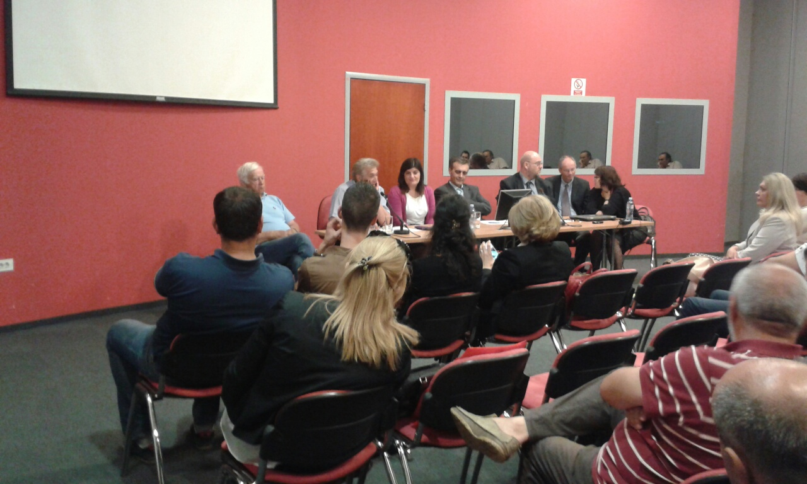

Slide 9
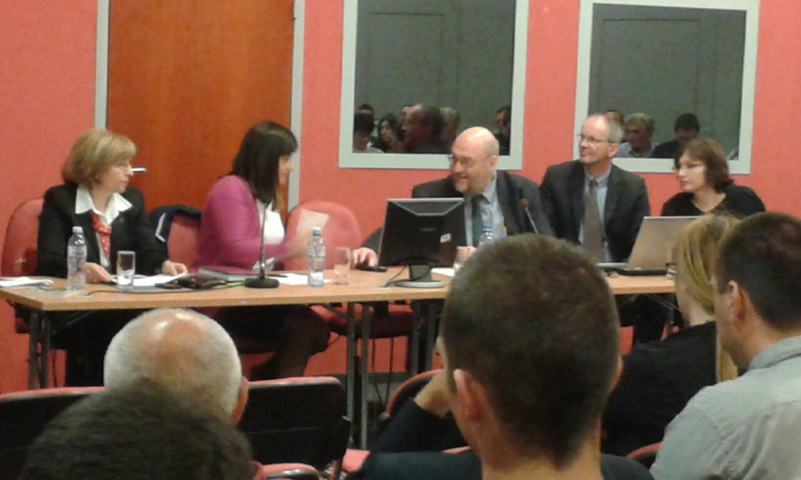

Slide 10
Thank you

